Slide 1
CSA1513
CLOUD COMPUTING
Cloud Storage Technologies
An Analytical Comparison of Object, Block, and File Architectures
DONE BY:
KAVIYA VARSHINI P S M
192371007

Slide 2

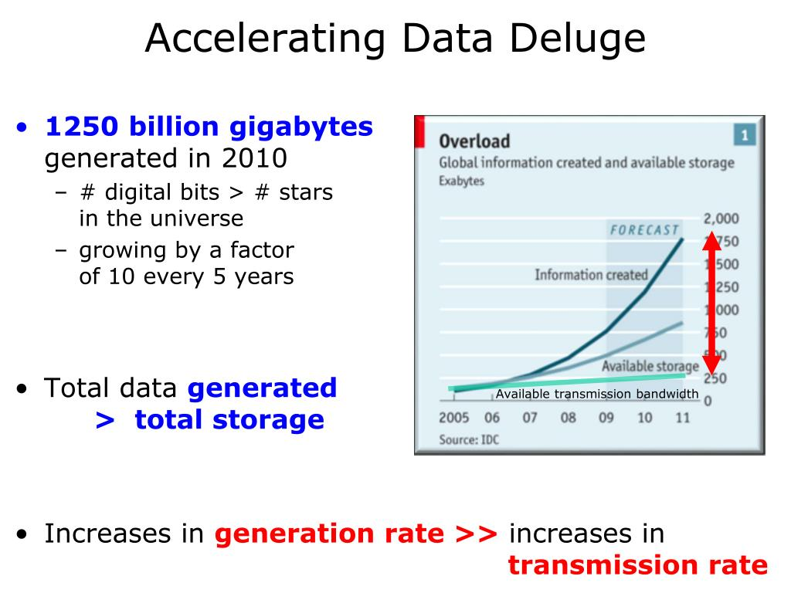
The Data Deluge
The digital universe is expanding at an unprecedented rate. To handle massive data ingestion, rendering, and processing, cloud providers have engineered highly specific storage architectures.
Choosing the right architecture is a critical business multiplier that dictates application performance, scalability limitations, and overall infrastructure capital expenditure.

Slide 3


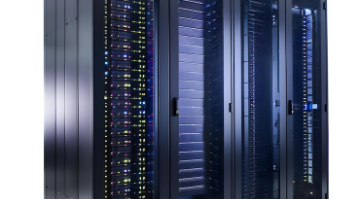
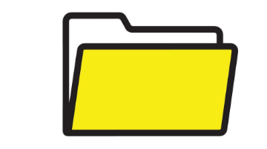
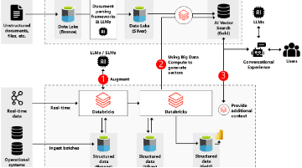
The Three Pillars of Cloud Storage
Block Storage
File Storage
Object Storage
Raw volumes split into fixed-size blocks. Engineered for absolute maximum speed and IOPS.
Hierarchical structure. Built for network sharing, concurrency, and human readability.
Flat namespace with rich metadata. Designed for infinite horizontal scale via HTTP APIs.

Slide 4

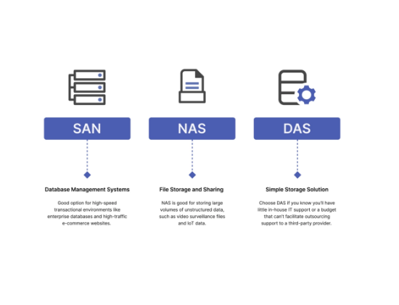
Architecture: Block Storage
■
Direct Attachment: Operates like a physical hard drive (SAN) attached directly to a single compute instance (VM).
■
Chunking Data: Files are broken down into evenly sized blocks, each with a unique identifier, with no metadata attached.
■
Low Latency Paths: Lacking OS overhead for file systems, data retrieval is incredibly fast, allowing for sub-millisecond latency.
■
OS Formatting: The guest operating system mounts the block volume and formats it (e.g., ext4, NTFS).

Slide 5






Block Storage: Primary Workloads
Transactional Databases
Boot Volumes
Mission Critical Apps
Relational databases (SQL, Oracle) demand the high IOPS and low latency that only block provides.
Virtual machines require block storage to boot operating systems rapidly in cloud environments.
Enterprise applications requiring strict performance SLAs leverage dedicated IOPS block volumes.

Slide 6
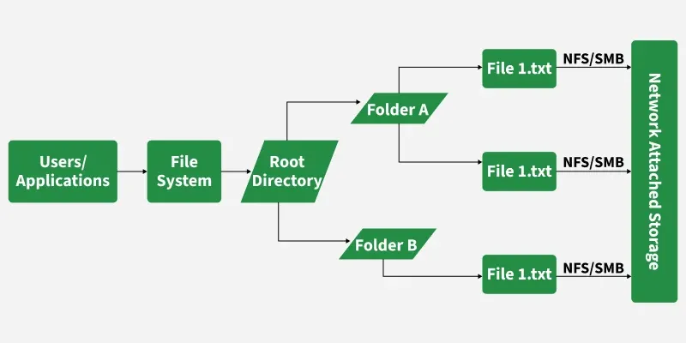
Architecture: File Storage
■
Hierarchical Tree: Data is organized into a rigid structure of directories, folders, and sub-folders.
■
Network Access: Attached over a network (NAS) rather than directly to the motherboard interface.
■
Standard Protocols: Utilizes standard protocols like NFS (Network File System) or SMB (Server Message Block).
■
Multi-Instance Concurrency: Allows thousands of virtual machines to read/write simultaneously with file locking.

Slide 7
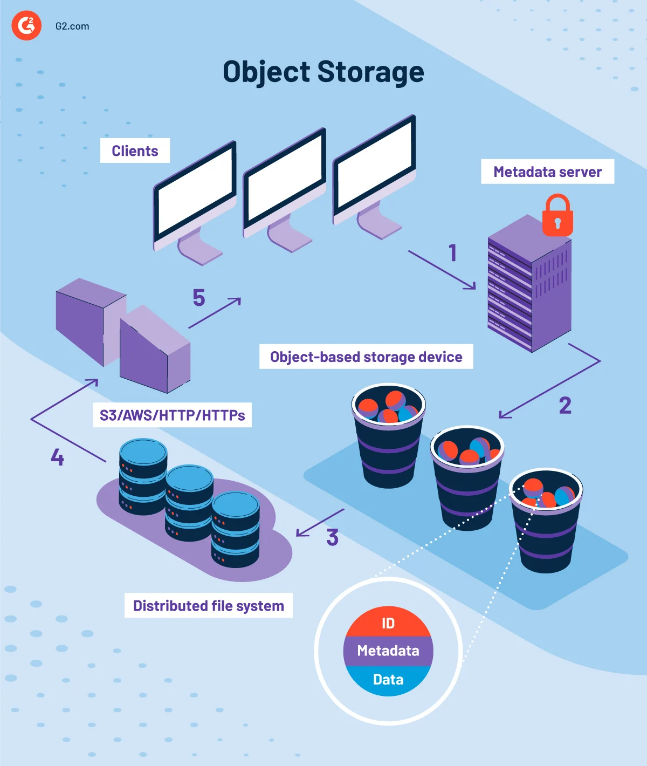
Architecture: Object Storage
The Flat Namespace: Object storage abandons the complex hierarchy of file storage and the raw chunks of block storage.
Data is bundled with extensive, customizable metadata and a globally unique identifier, dropped into a massive, flat bucket.
API-Driven: It is not mounted by an OS. Applications retrieve objects directly over the internet using standard HTTP REST APIs (GET, PUT, DELETE), enabling virtually infinite scalability.

Slide 8
Architectural Comparison Matrix
Metric | Block Storage | File Storage | Object Storage
Structure | Raw volumes | Hierarchical (Tree) | Flat (Buckets)
Metadata | None (OS dependent) | Limited (Creation date) | Rich & Customizable
Accessibility | Single attached instance | Network shared (NFS) | HTTP/REST API
Updates | Edit partial blocks directly | Edit file components directly | Overwrite entire object
Primary Driver | Absolute Performance | Shared Accessibility | Infinite Scalability

Slide 9
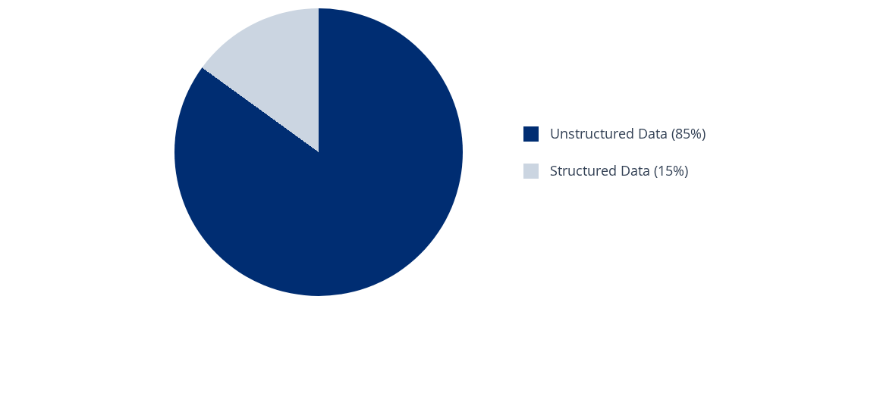
The Catalyst for Object Storage
The massive proliferation of unstructured data cannot be cost-effectively managed by Block or File architectures, cementing Object storage as the modern standard.

Slide 10
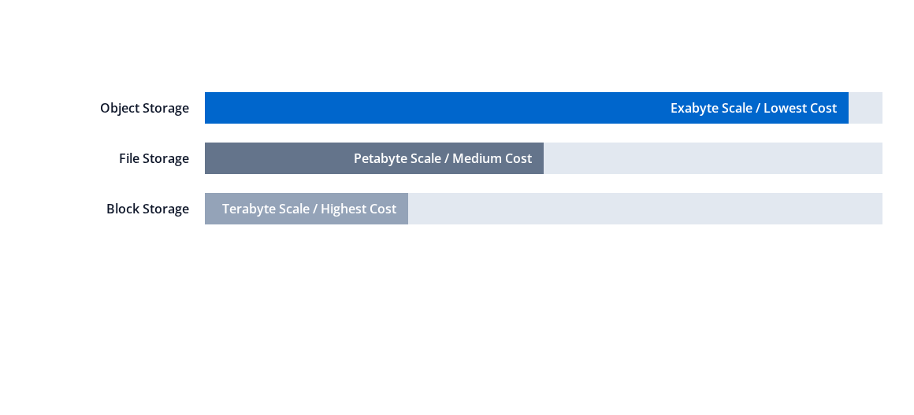
Cost Efficiency vs Scalability Index
While Block storage is essential for high-speed computation, its cost per GB makes it prohibitive for deep archiving. Object storage provides the economics for mass retention.

Slide 11
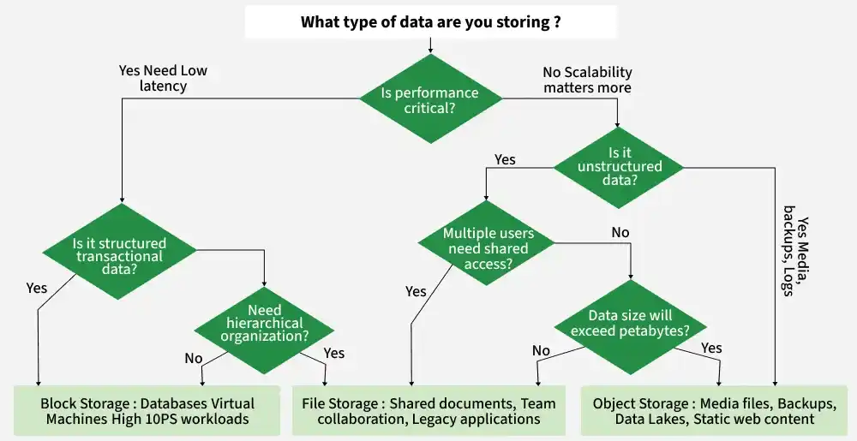

Slide 12
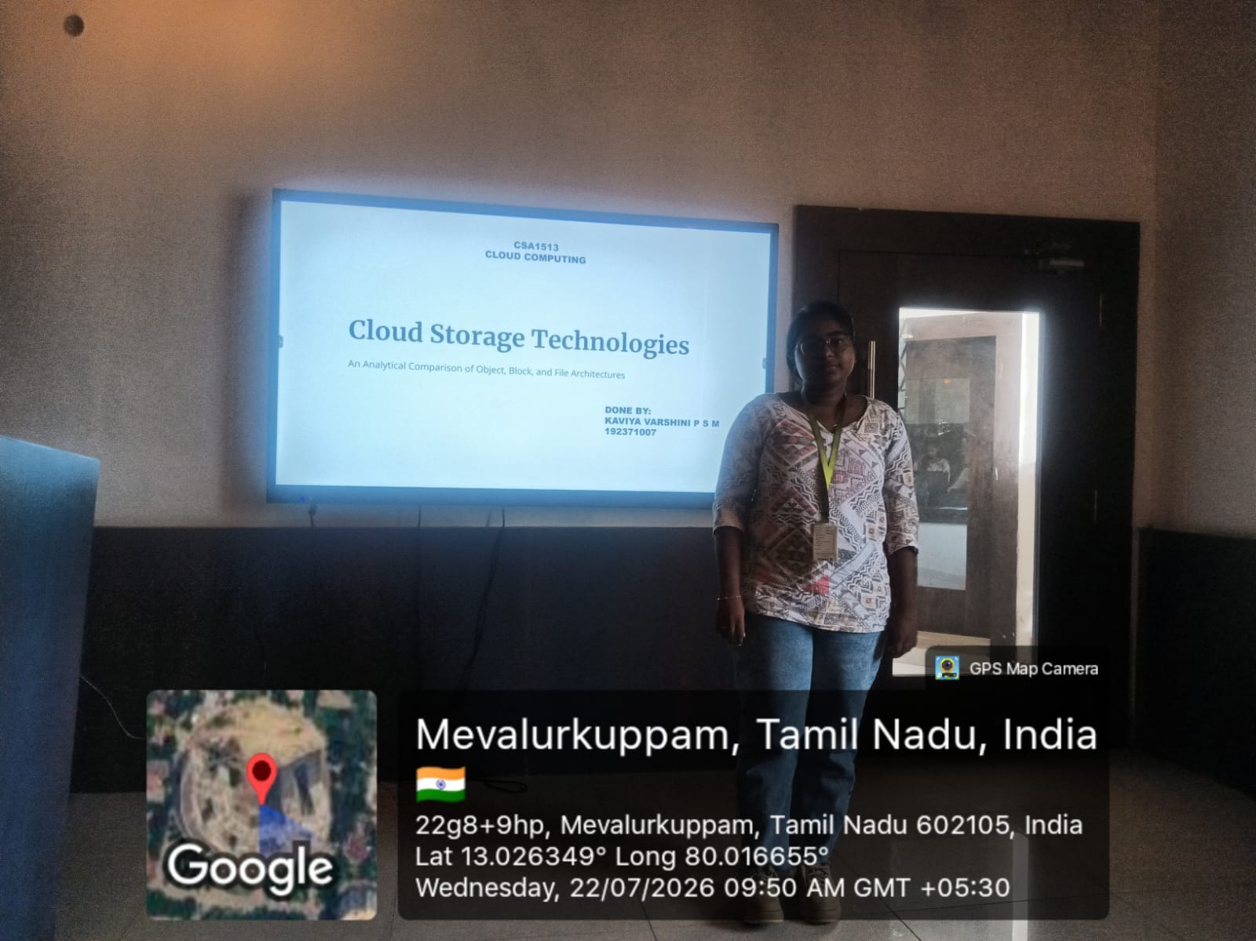
GEOTAG:

